Slide 1

Orenburg region – together we'll succeed
Notes:
Оренбуржье - быть успешными вместе

Slide 2
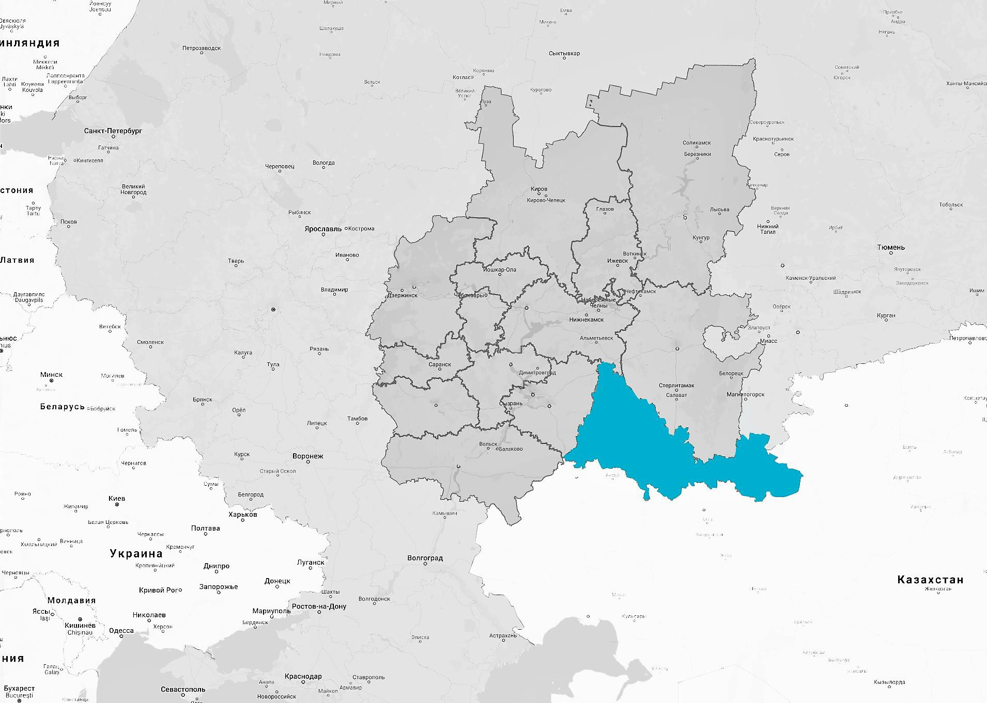




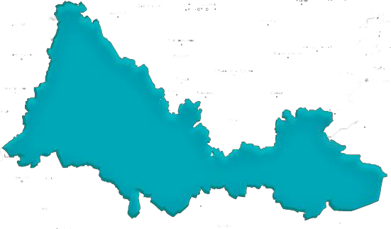


Orenburg region – a distribution center for products in the Volga Federal District
Perm
Nizhny Novgorod
Yekaterinburg
Within 1000-kilometer radius there are:
2 hours
MOSCOW
20 hours
Kazan
Chelyabinsk
› 9 cities with over 1 million inhabitants
› 4 key cities in northwest Kazakhstan
25 hours
Ufa
Kostanay
Samara
Saratov
Cargo delivery time takes less than 10 hours to cities of the Volga Federal District from Orenburg region
Uralsk
Aktobe
Volgograd
Атырау

Slide 3
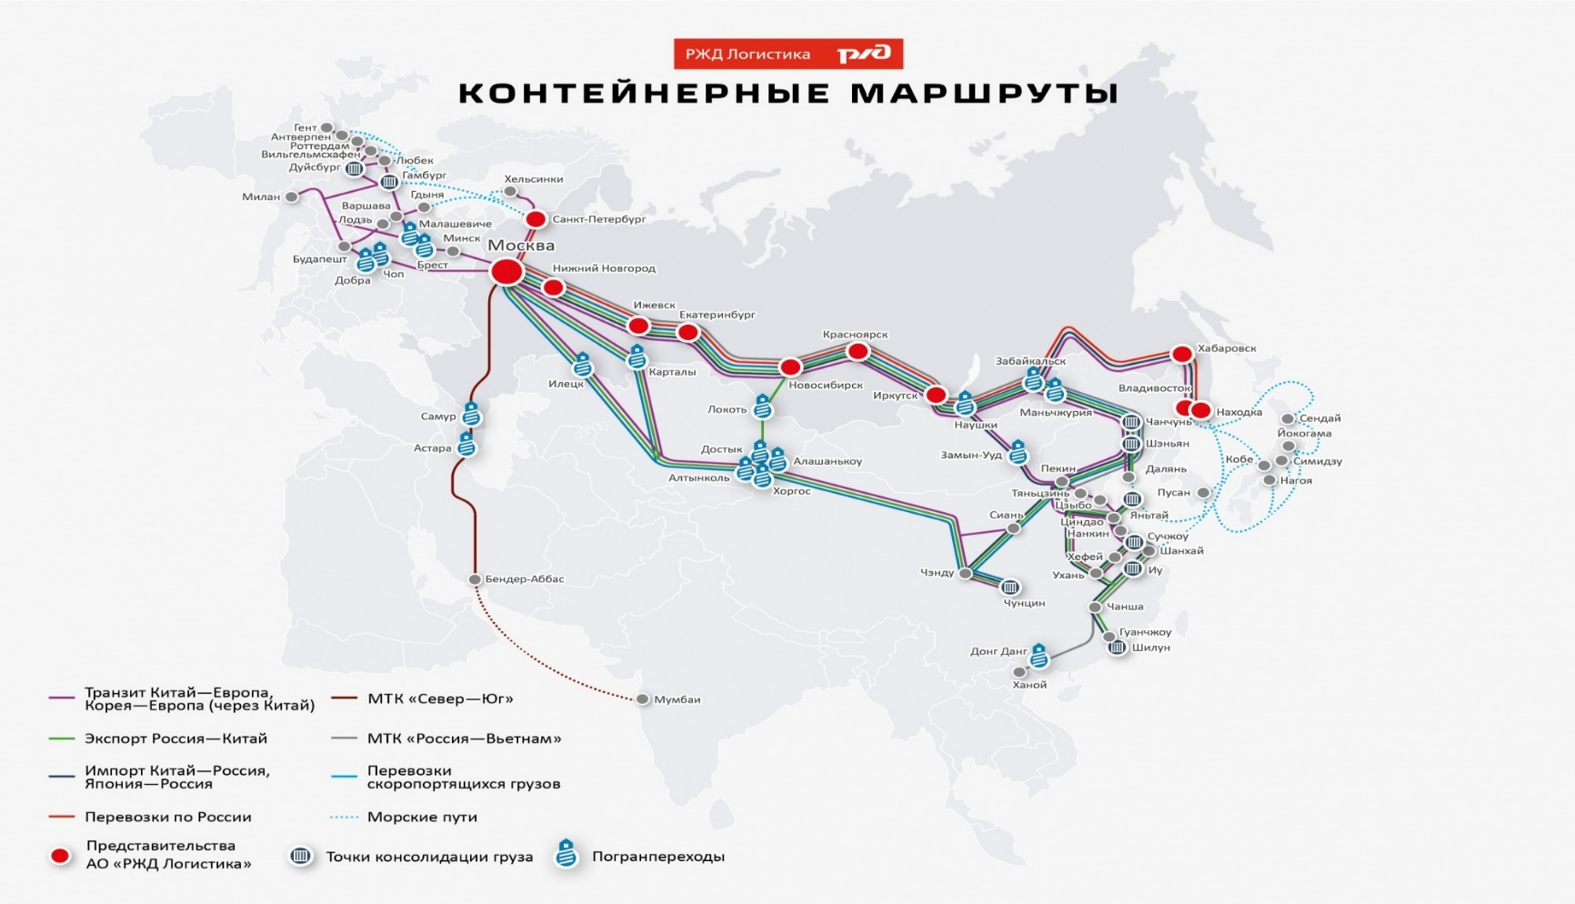
PROJECT OF A NEW RAILWAY ROUTE FOR CONTAINER TRANSPORTATION RUSSIA – CHINA VIA ORENBURG REGION
Results: lower transportation costs and reducing delivery time
Route Russia-China
via Orenburg region (Sol-Iletsk) 4 422 km
via Zabaikal'sk – 6 641 km.
Stages of implementation:
I stage – coupling trains (containers) in the Orenburg region;
II stage – Development of multimodal logistics center in the «Orenburzh'ye» special economic zone and formation a container train near station «Iletsk-1».
The route Russia-Uzbekistan is under development
via Orenburg region (Sol-Iletsk)
Orenburg region

Slide 4
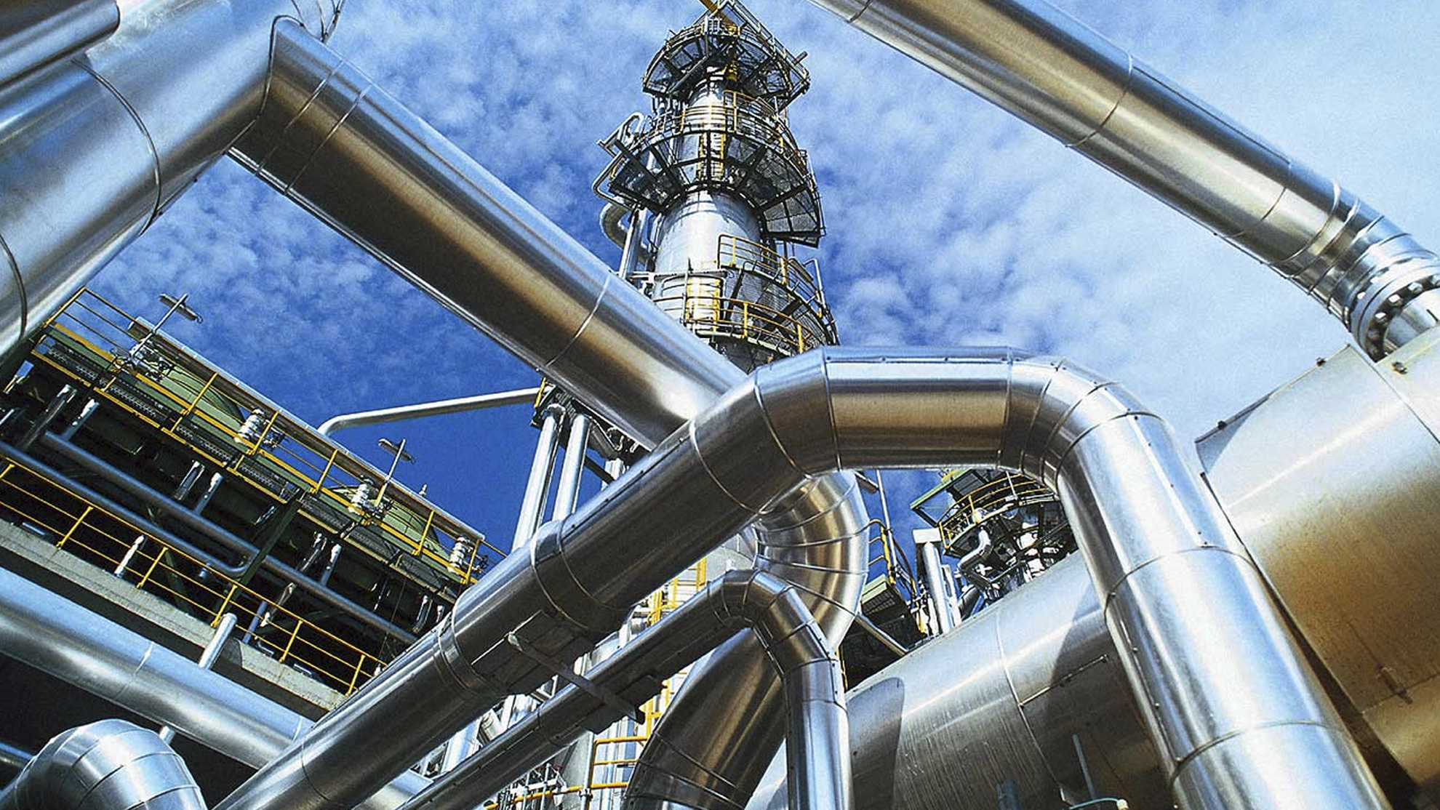





Orenburg region – industrial region
3000
Fuel and energy industry
industrial companies
Metallurgy
including
Machinery
300
Mining industry
SMEs
Agriculture
Notes:
300 Small and medium-sized enterprises

Slide 5

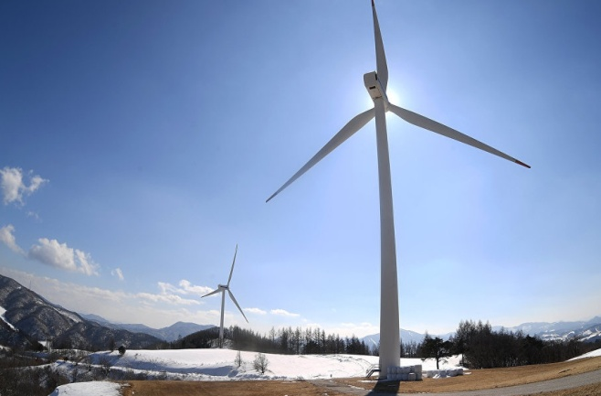

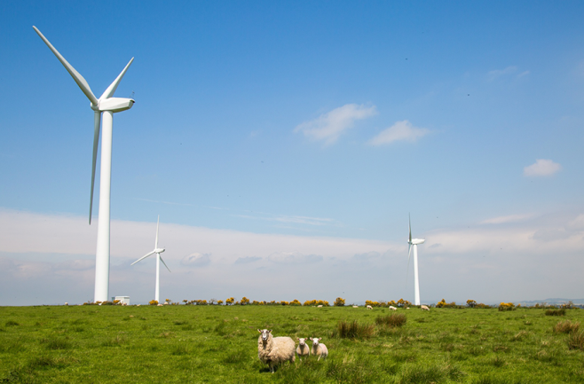
New energy
Orenburg region is the leading region in the development of renewable energy sources.
12 photovoltaic power stations have been constructed in the region for 4 years with a total capacity of 260 megawatts.

Slide 6






Orenburg region has a well-developed agricultural sector
212 000
tons of meat
636 800
tons of milk
6 030 669
hectares of arable land
or 5% of all Russia’s total arable land
1.02 billion
pieces of eggs
581
tons of wool
3 861 000
tons of grain

Slide 7
Orenburg region is a reliable partner for Hungarian business
Trading partners
90 countries
2,04
Export (billion USD)
0,29
Import (billion USD)

Slide 8

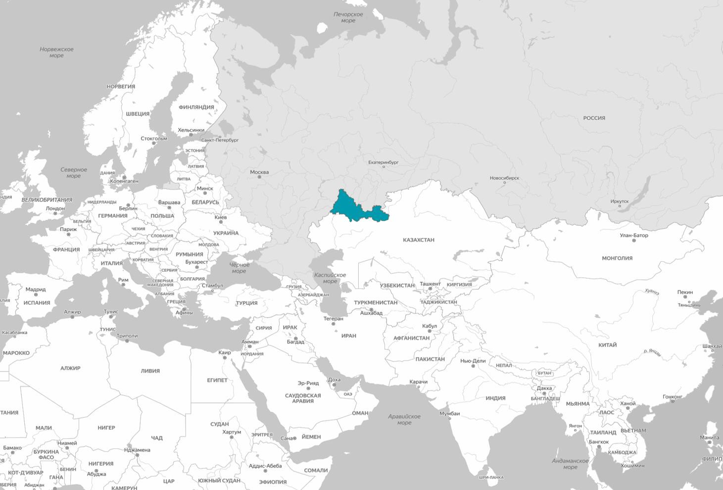


Hungary is one of the key partners of the Orenburg region.
The bilateral trade volume in 2019 amounted to 81.3 million USD:
export – 80.4 million USD,
import – 0.9 million USD.
The basis of export – oil and
mineral fuels.
The basis of import – machinery, parts of motor vehicles.
Orenburg region is a reliable partner for Hungarian business
USA
Latvia
Belarus
Казань
Netherlands
Kazakhstan
Hungary
Европа
3 дня
Italy
Azerbaijan
Kyrgyzstan
Turkey
Tajikistan
China
Киргизия
3 дня
Иран
3 дня
Uzbekistan
Китай
4 дня
7
Notes:
Оренбуржье – надежный деловой
партнер для венгерского бизнеса
По итогам 2019 году объем взаимной торговли составил 81,3 млн. долларов США:
экспорт – 80,4 млн. долларов США;
импорт – 0,9 млн. долларов США.
Основа экспорта – нефть и нефтепродукты.
Основа импорта – механизмы, части для моторных транспортных средств

Slide 9
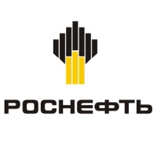







We successfully cooperate with the largest Russian and international companies
 | Rosneft – production of oil |  |  | Orenbeef – slaughterhouse and beef processing plant
 | Gazprom – production of natural gas |  |  | John Deere – production of agriculture equipment
 | Metalloinvest (Uralskaya Stal) – metal production and the manufacture of fabricated metal products |  |  | Bosal – manufacture of automotive equipment
 | Ural Mining and Metallurgical Company – metal production and the manufacture of fabricated metal products |  |  | Vilofoss – production of animal feed and farm premixes

Slide 10




Contacts:
Minister of Economic Development, Investment, Tourism and Foreign Relations of the Orenburg region
Goncharov Denis Viktorovich

