Slide 1

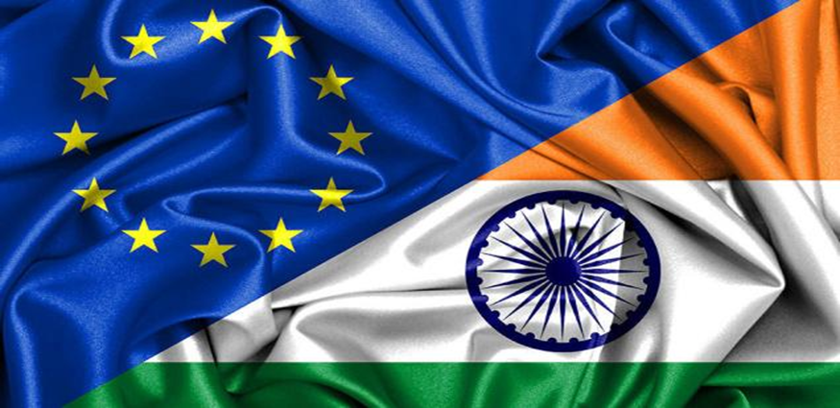
THE COUNCIL OF EU CHAMBERS OF COMMERCE IN INDIA
ENHANCING EU – INDIA TRADE RELATIONS

Slide 2

THE COUNCIL OF EU CHAMBERS OF COMMERCE IN INDIA
A Unique Chamber of Commerce

Slide 3
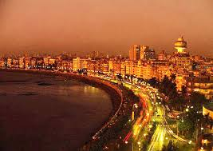


INTRODUCTION
A foremost trade promotion organizations in India established in 1992 to
promote, foster and extend commercial and economic relations between
India and the EU
Membership represents sectors such as banking & financial infrastructure,
automobiles, Pharma, electrical and engineering, shipping and logistics,
consultancy & services, Information Technology, Mining, textile, Energy,
Agro products etc.
Primary promoters consists of European Bi National Chambers such as
Indo-French, Indo- German, Indo Italian and 10 European Bi National
Business Committees

Slide 4


"To provide quality services to our members and society at large enabling them to grow qualitatively & quantitatively, to strengthen EU India relations."

Slide 5


Be India's key business forum for information about the European Union.
Be India's key forum for networking between European and Indian business people.
To act as a facilitator to strengthen EU India economic ties.
Act as advisor to the members with the help of its expert committees.

Slide 6

CECCUI
To accelerate the growth of EU-India Trade Relations.
To promote two way trade & investment flow between Indian & EU countries.
To act as a platform for EU- Indian businesses to explore possibilities of exports, imports, joint ventures, technology exchange & trade dialogues.
To publish theme paper on different topics related to EU- India

Slide 7

WHAT WE DO
EVENTS
Annual Europe Day.
Conferences & Workshops.
PUBLICATIONS
Business Pulse.
BUSINESS SUPPORT
Trade & Investment leads.
Panel Discussions.
Networking.
Members Directory.
Annual Report.
Economic & Commercial Reports.
Assistance in partner search.
Host Foreign Business Delegation.
Visa Facilitation.

Slide 8

SERVICES
Events
  Regular Interactive Meetings/ Round table/ Panel discussion/workshops Training programs for SMEs
  Chamber focuses on the activities on those countries that do not have a strong representation in the form of Bilateral Chambers or Trade Organizations. It also focuses on issues other than sectors.
  Chamber also releases position papers on various theme.
Business Support
  Provides trade leads received from Chambers & Embassies across EU.
  Organizes B2B meetings with visiting delegations
  Visa recommendations
  Regularly surveys are conducted to understand the needs of the members.

Slide 9
SERVICES
MoUs
  Several MoUs signed with various organizations.
  Attempts are made to make these MOUs useful to the members.
Publications
  Business Pulse is published on Bi-Monthly basis.
  E-newsletter on a monthly basis covering latest information on EU-India trade and various policy changes in EU & India.
Membership
  Categorization of Membership by sector, region & type –Approx. 1000 Cos.
  Activities organized according to the interest of members.

Slide 10

MEMBERSHIP PROFILE
MAJOR SECTOR FOCUS
Automobile
Banking & Financial Institution
Building and Construction
Higher Education
Machinery & Equipment
IT & Electronics
Logistics
Pharmaceuticals

Slide 11
MEMBERS’ BENEFITS
Events:
Discounted tariffs at events organized by us and our Partner organizations.
Invitation to exclusive events.
Preferential rates for sponsorship at various events.
Publications:
Opportunity of showcasing member’s updates in Newsletters & Discounted advertisement tariffs.
Complimentary Member’s Directory & Listing in it to enjoy wide publicity free of cost.
Complimentary subscription to all publications.
Business Support:
Access to Air-conditioned meeting room at concessional rates.
Access to the free Information Service.
Access to our various Specialized Committees.

Slide 12
MEMBERS’ BENEFITS
Life Member’s additional Benefits:
Membership for lifetime & no renewal.
Registration fee waived for a representative for all the events organized in India.
Interview/Article of the Chairman/MD/CEO in Business Pulse.
One complimentary insertion of advertisement in the Business Pulse.
A Company can participate in the Council’s stand on all essential EU-India relations.

Slide 13
INBOUND DELEGATION

Slide 14
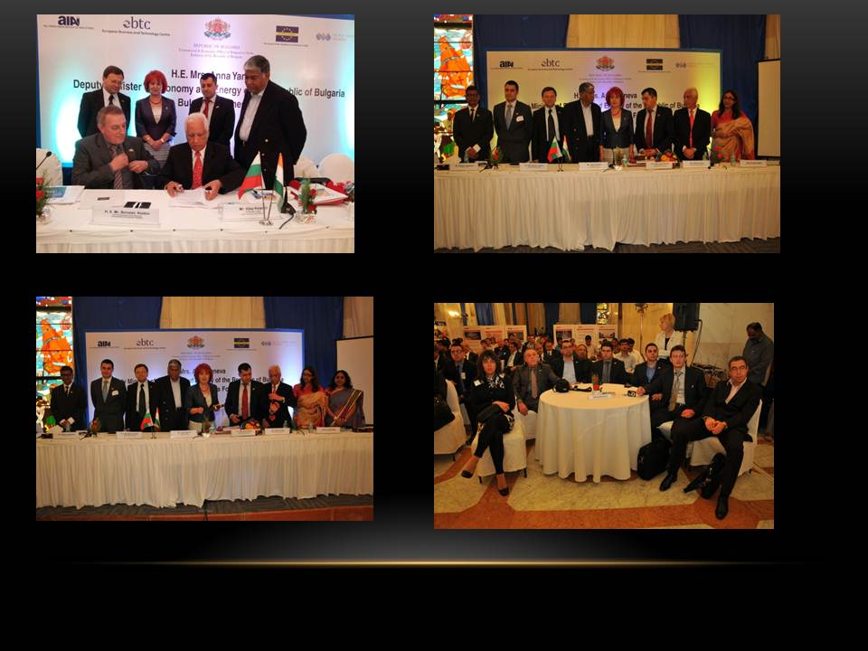
BULGARIAN DELEGATION TO INDIA

Slide 15
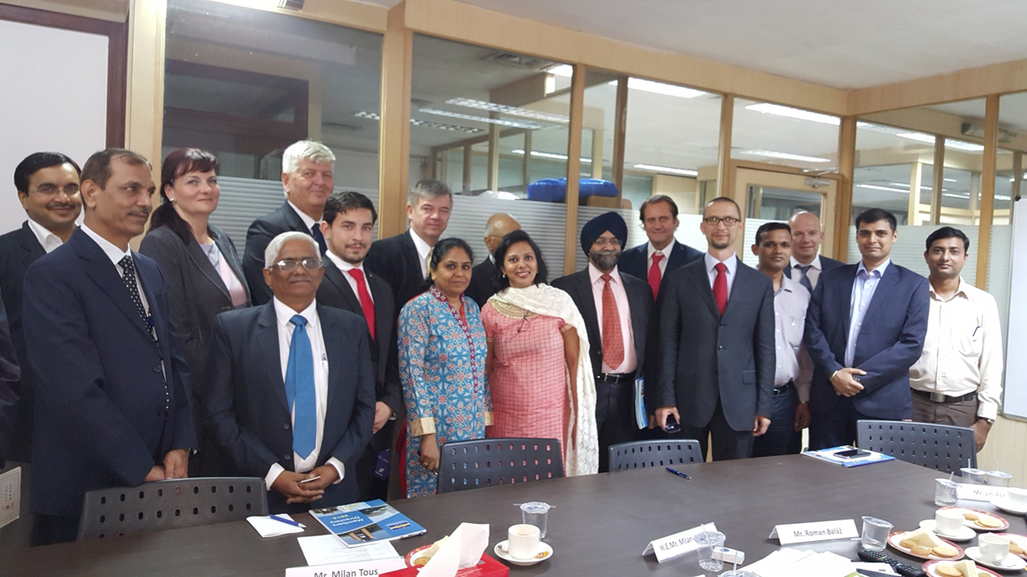
CZECH DELEGATION TO INDIA

Slide 16
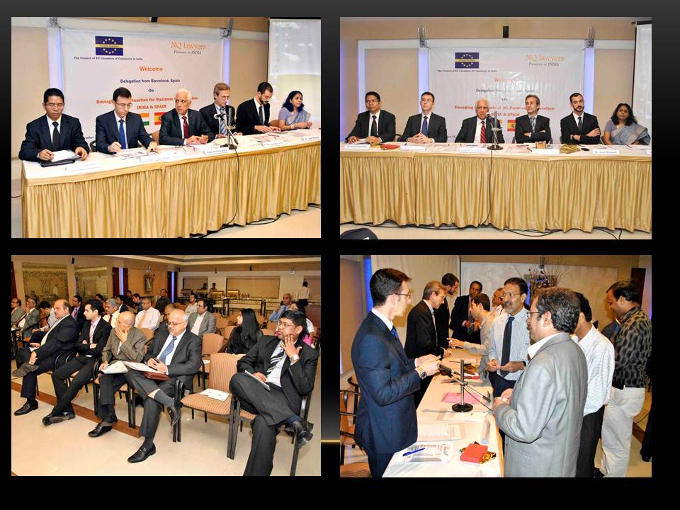
SPANISH DELEGATION TO INDIA

Slide 17
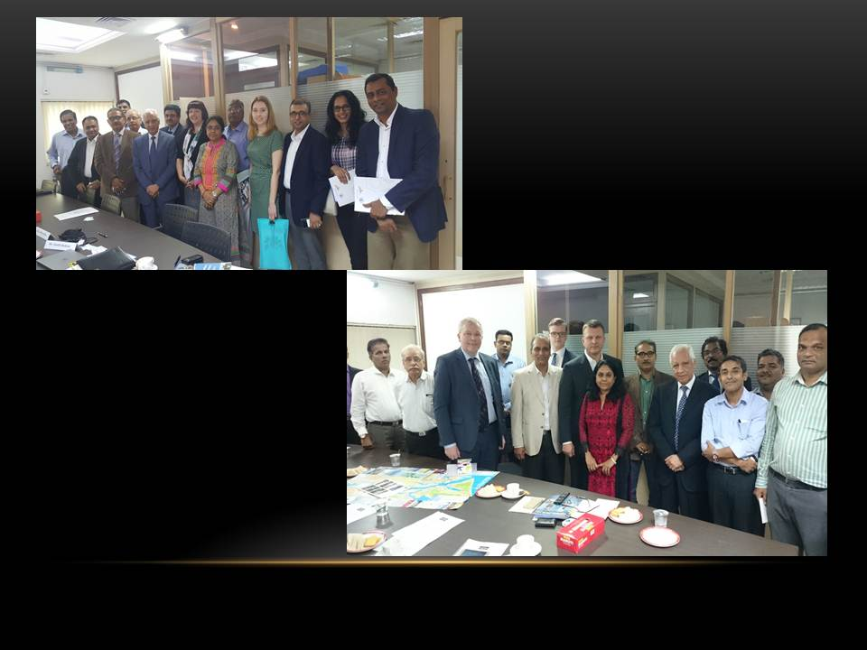
LATVIAN DELEGATION TO INDIA

Slide 18
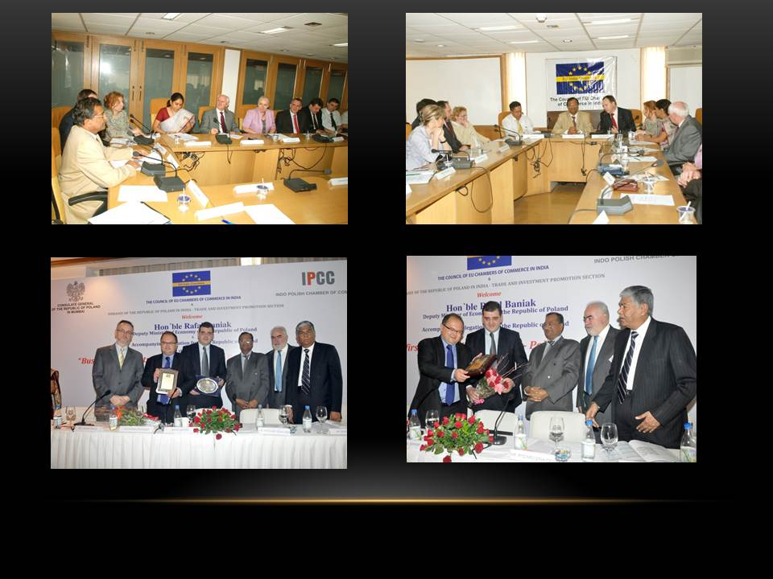
POLISH DELEGATION TO INDIA

Slide 19
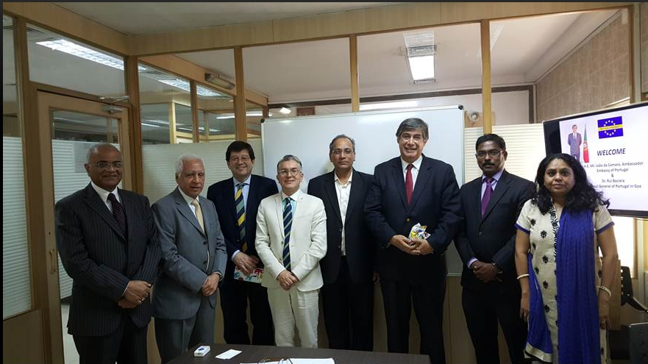
PORTUGUESE DELEGATION TO INDIA

Slide 20
OUTBOUND DELEGATIONS

Slide 21
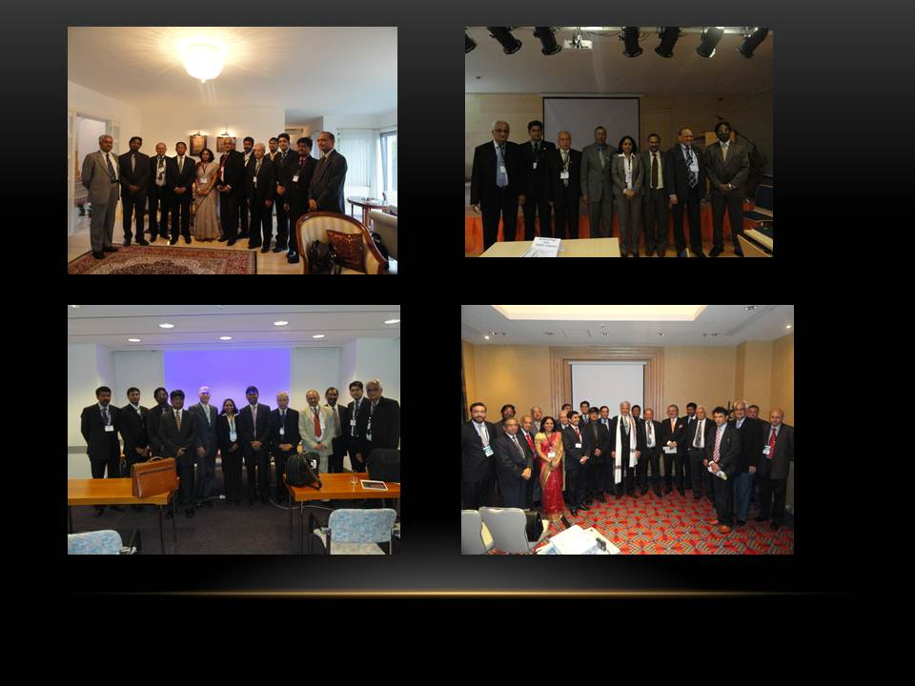
DELEGATION TO CENTRAL EUROPE

Slide 22
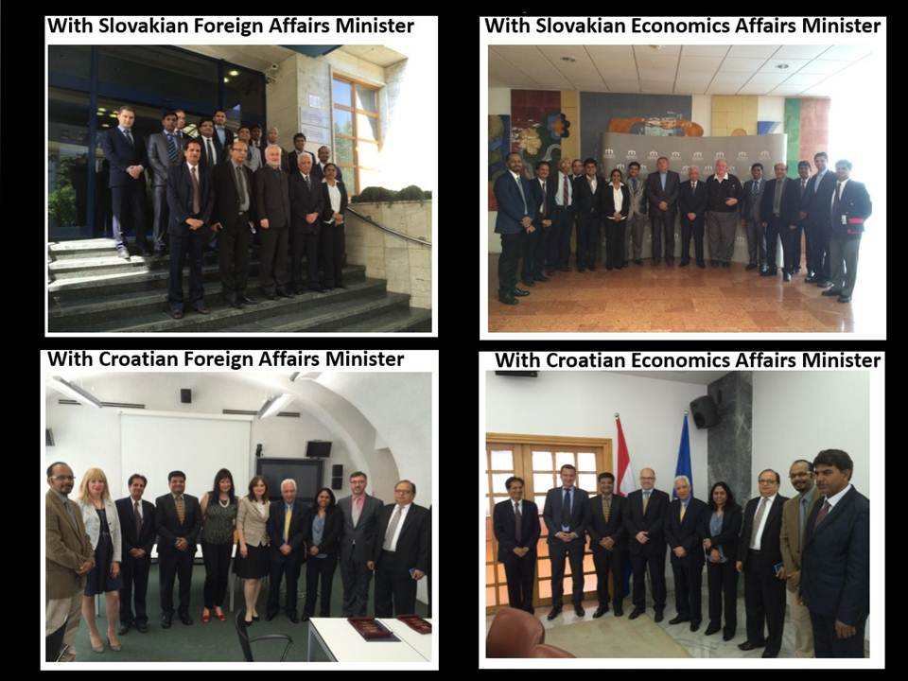
DELEGATION TO EASTERN EUROPE

Slide 23
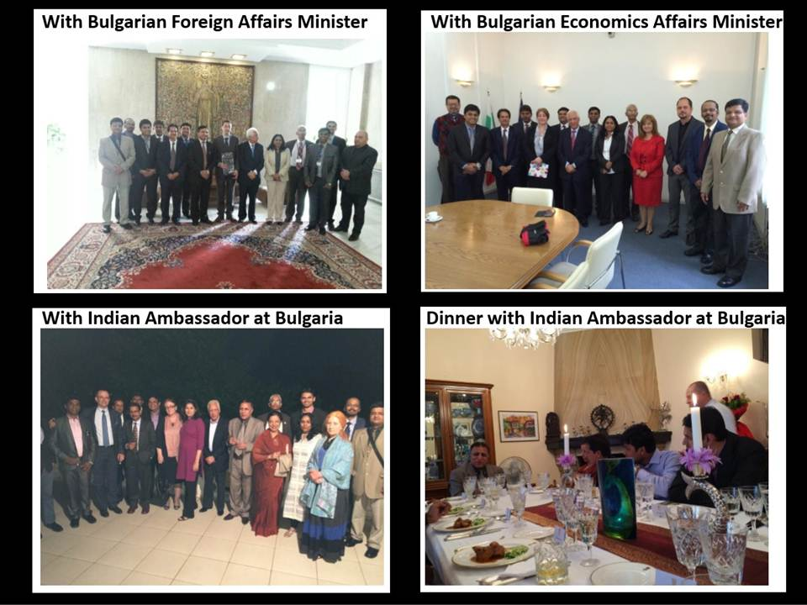

Slide 24
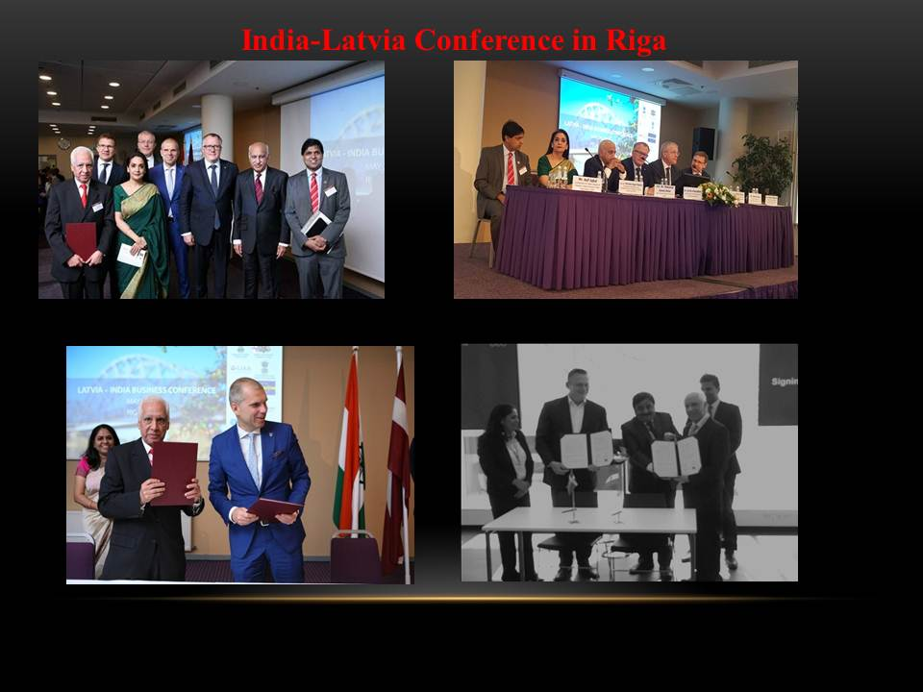
DELEGATION TO LATVIA & SCANDINAVIA

Slide 25
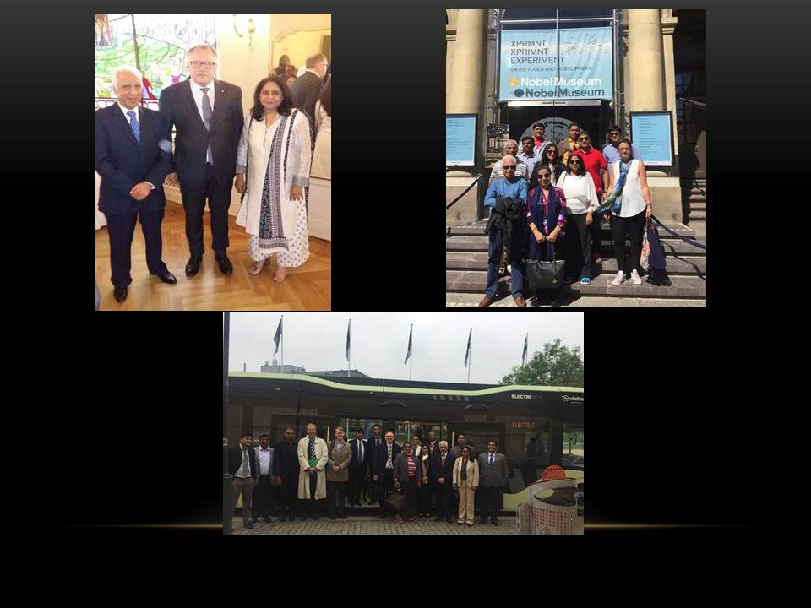
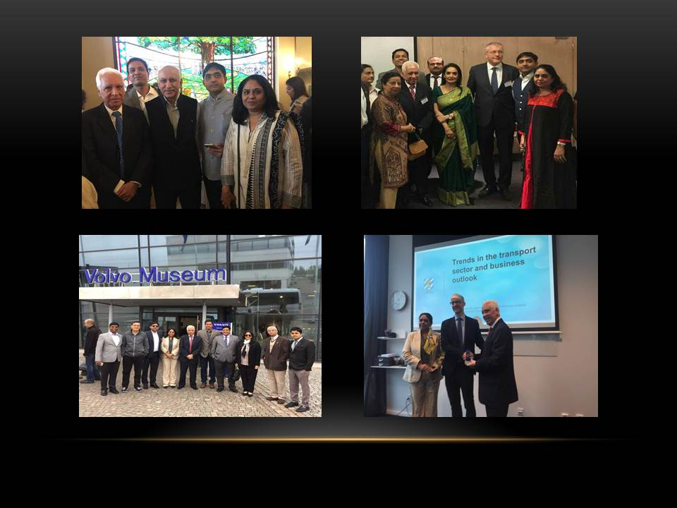

Slide 26
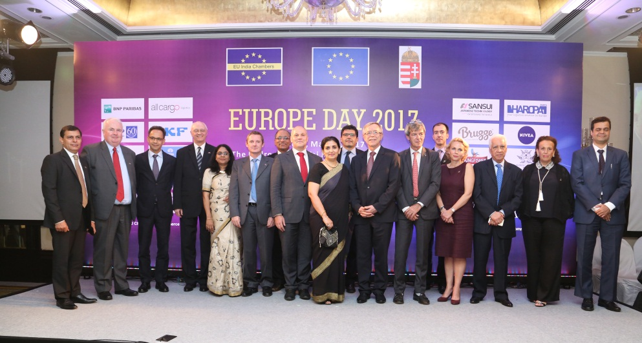
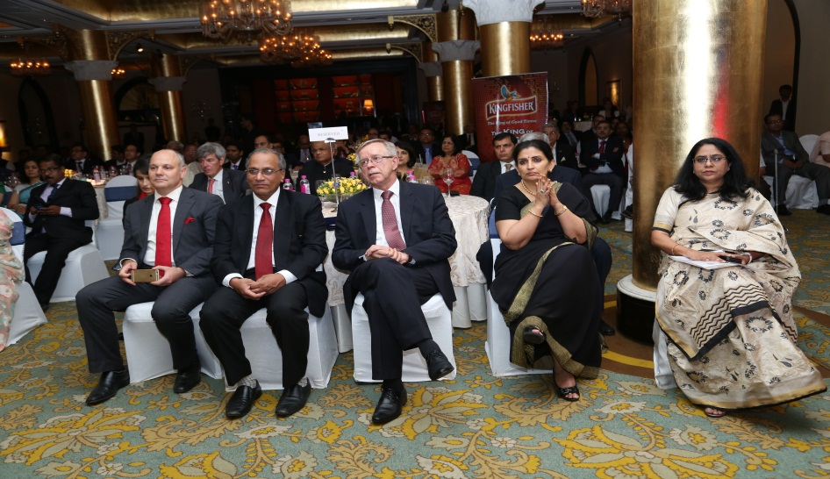
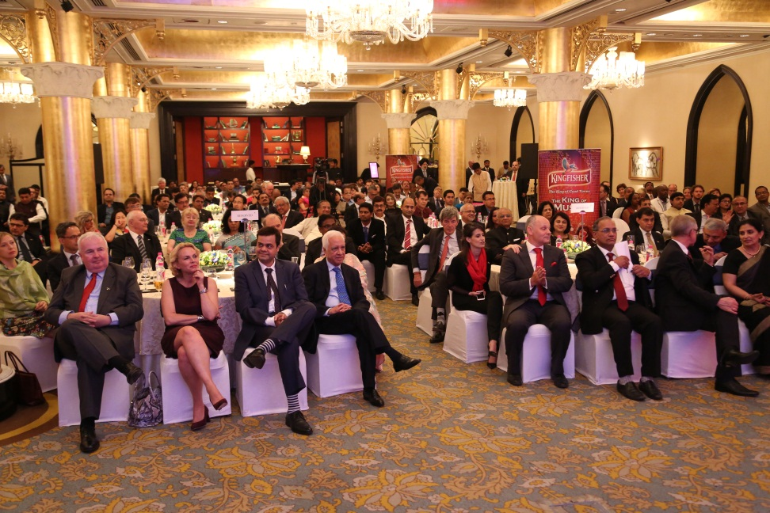
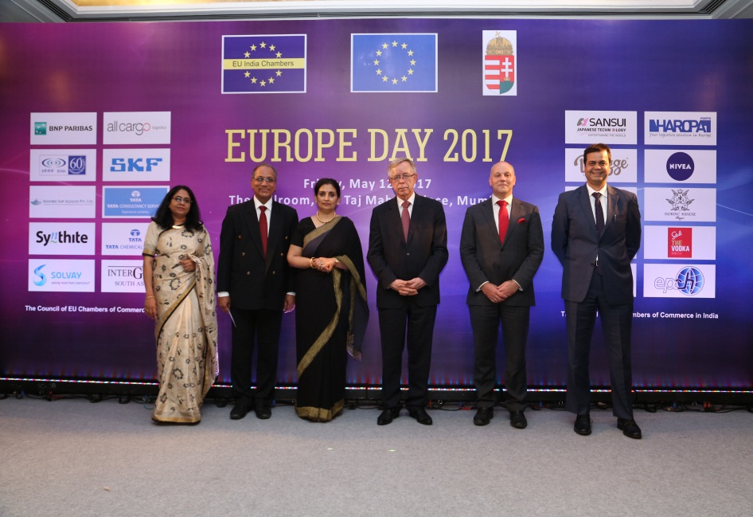
EUROPE DAY CELEBRATION 2017

Slide 27
25th ANNIVERSARY

Slide 28
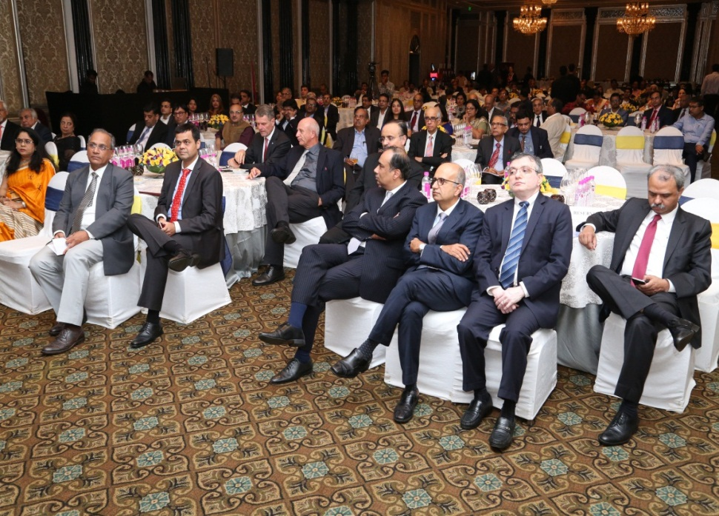
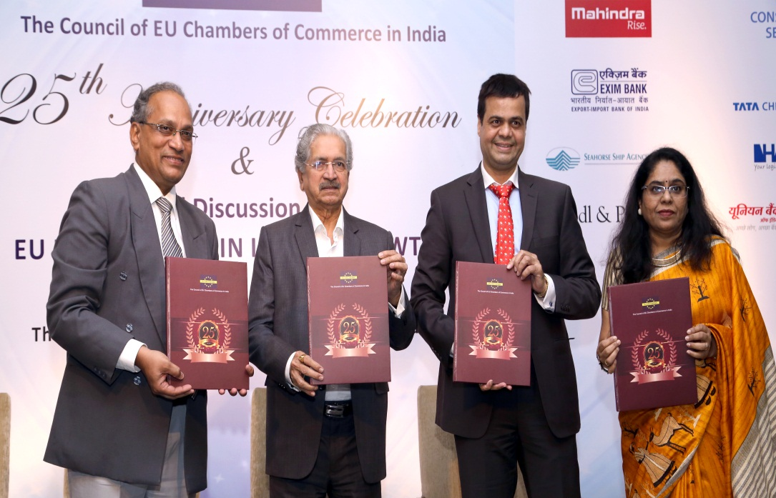
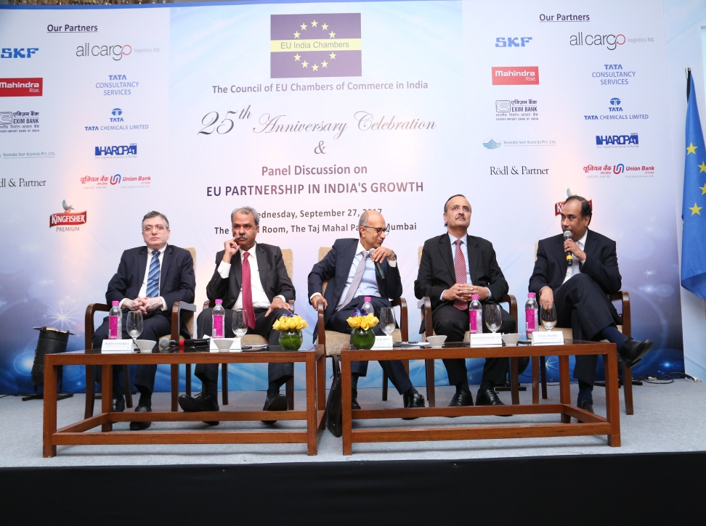
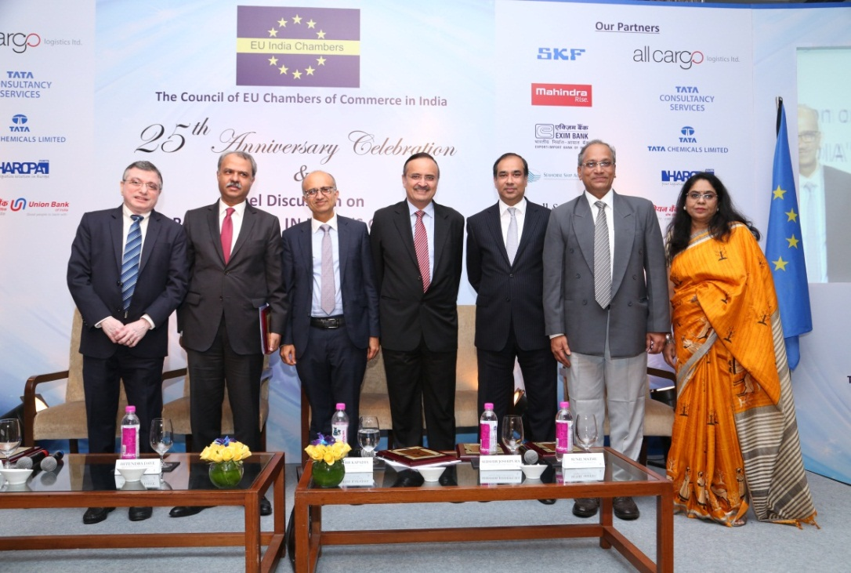

Slide 29
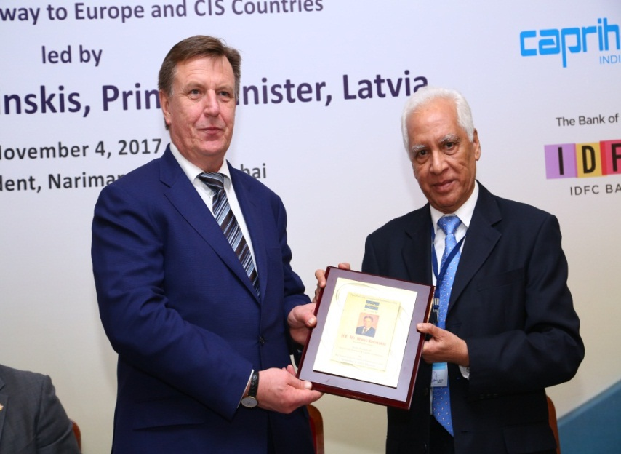
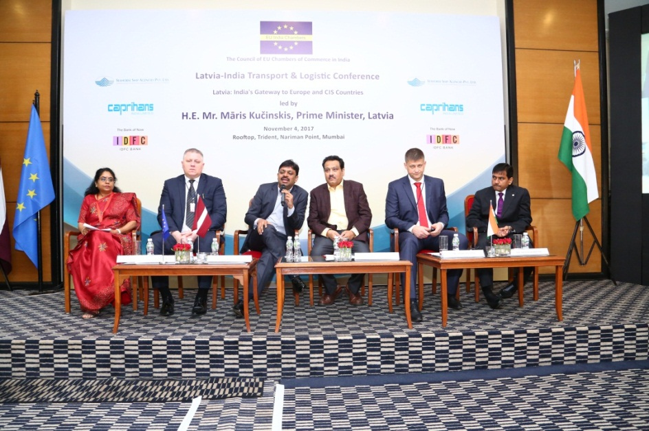
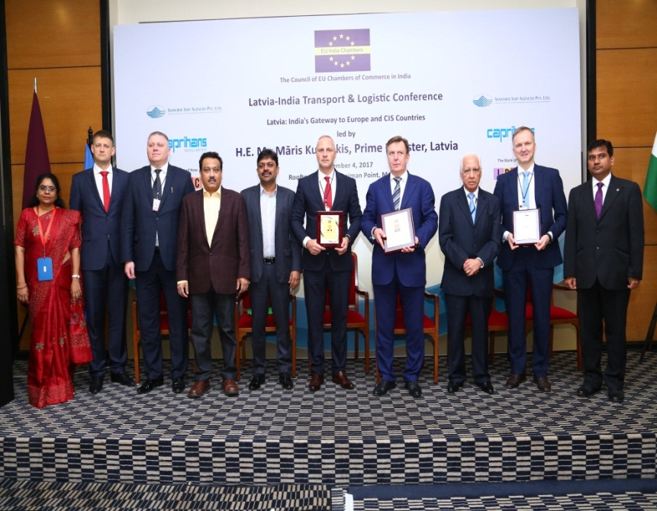
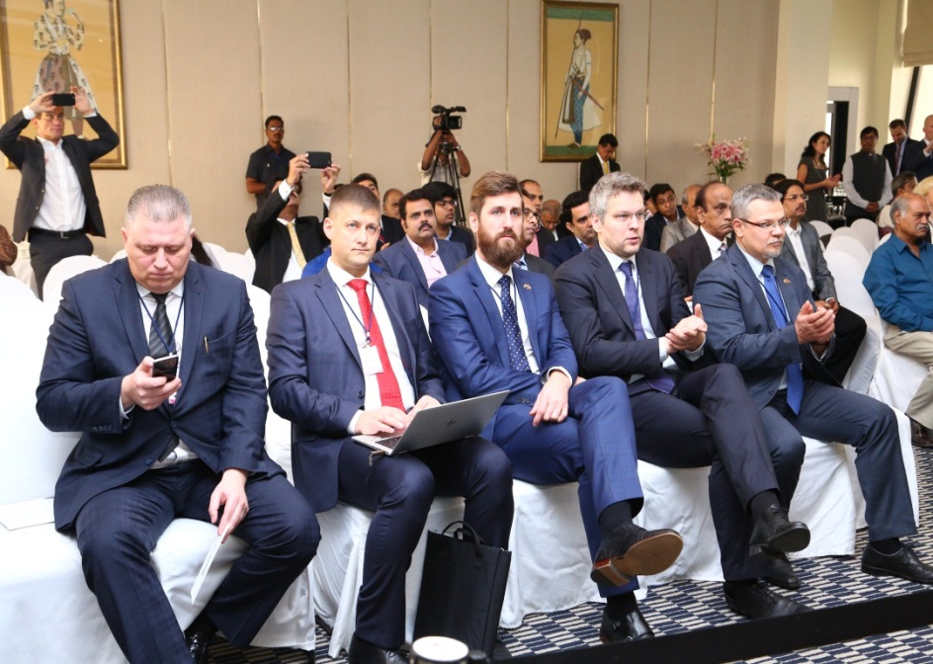

Slide 30
EUROPE DAY CELEBRATION 2018

Slide 31
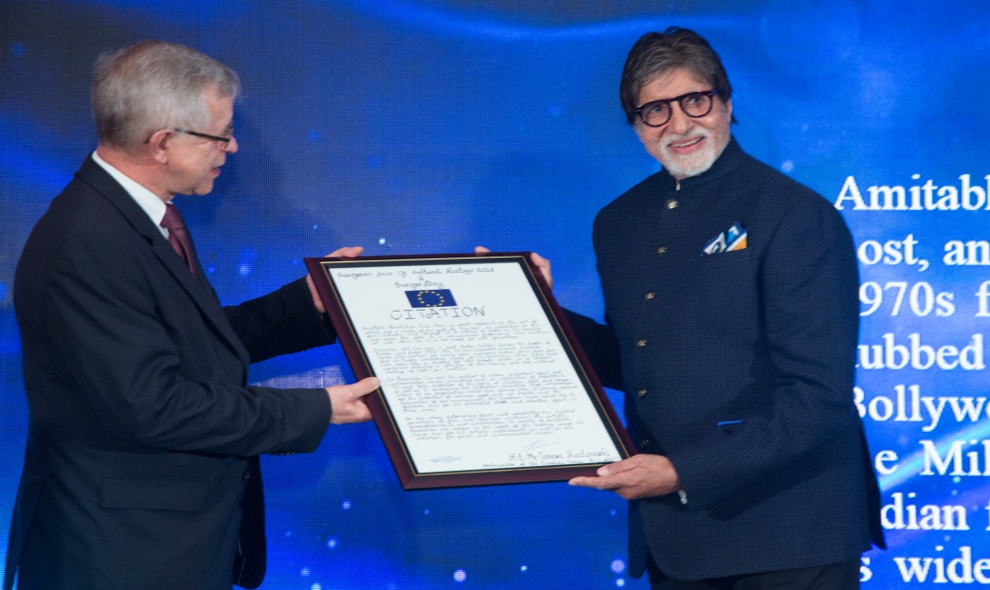
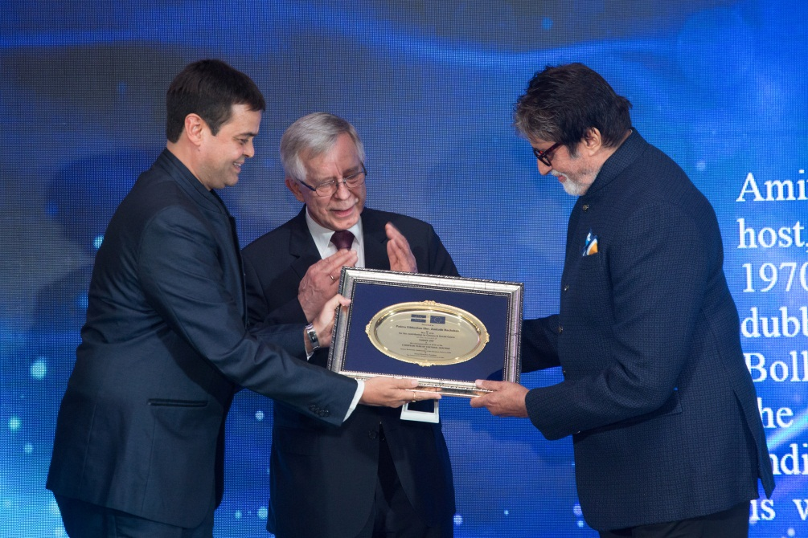
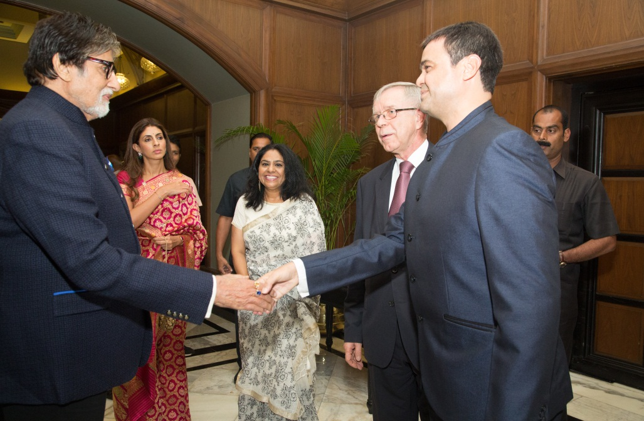
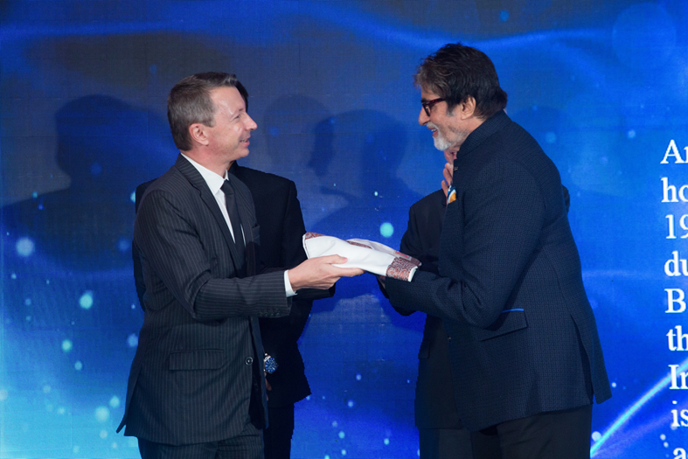

Slide 32
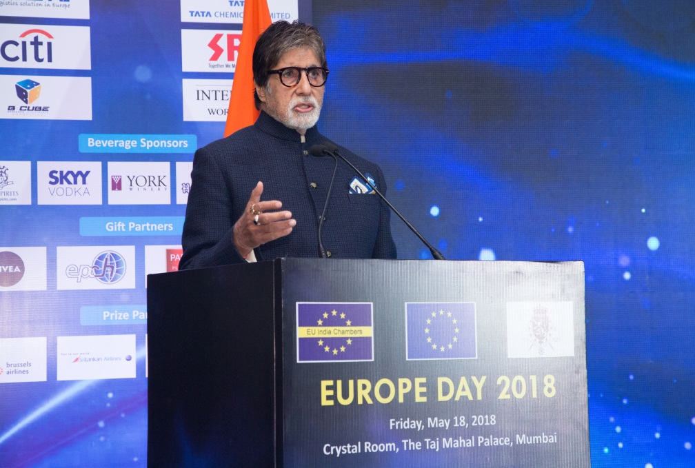
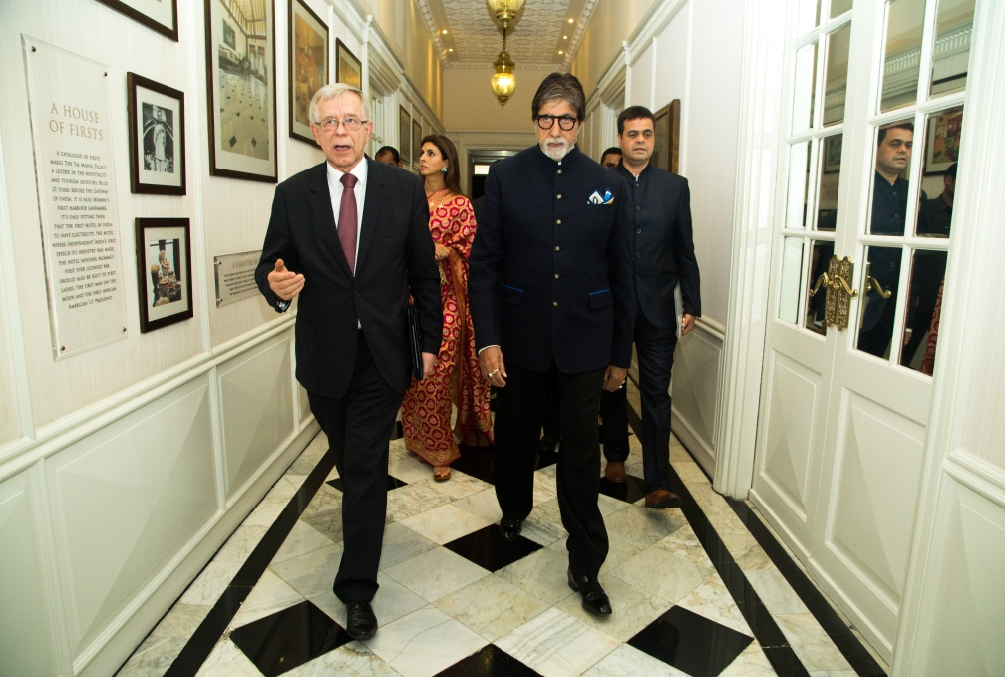
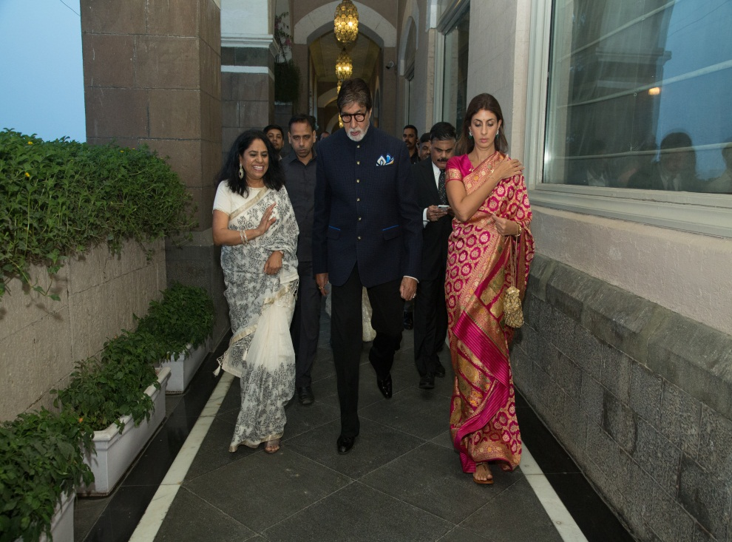
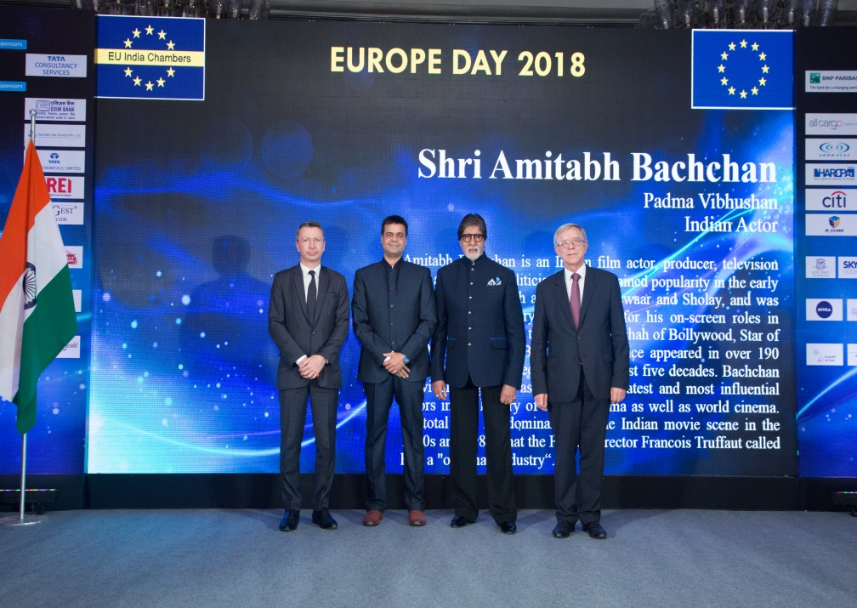

Slide 33
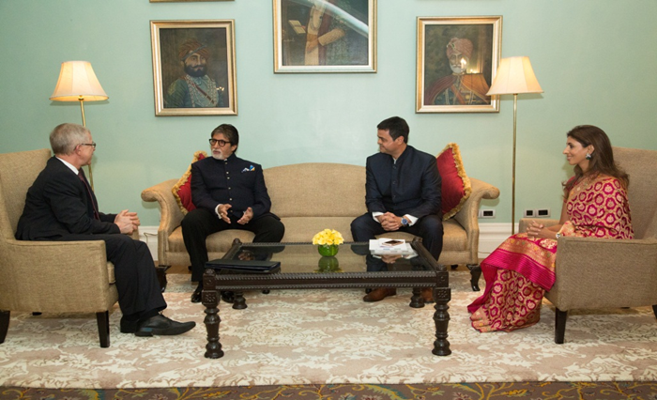
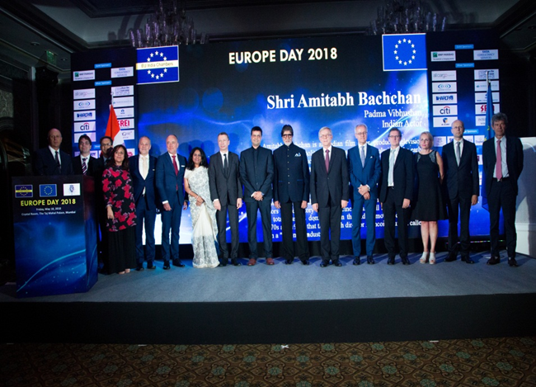
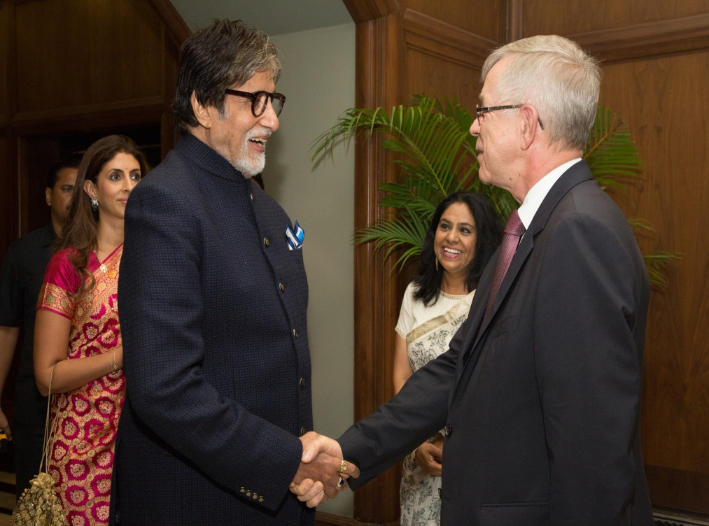
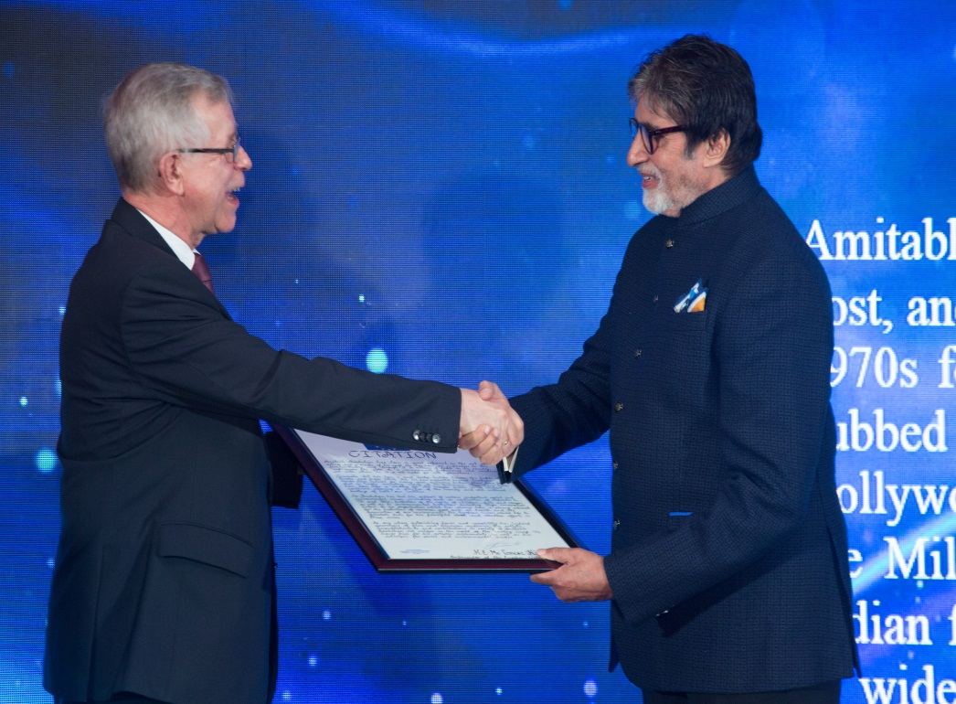

Slide 34
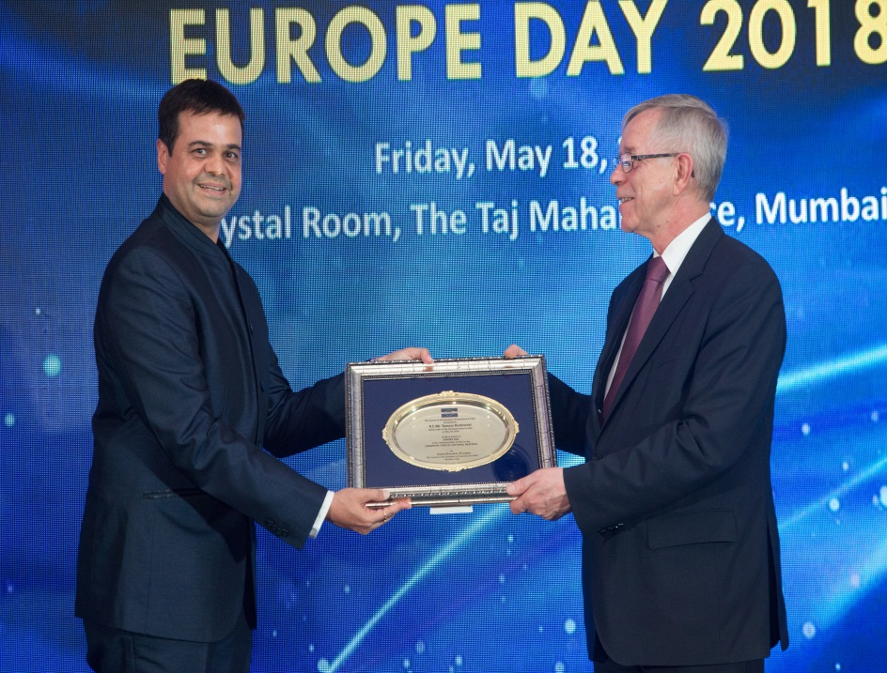
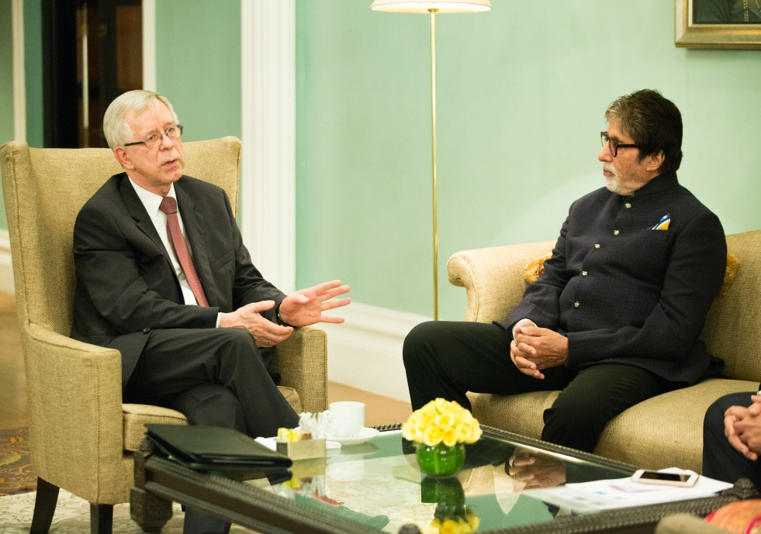

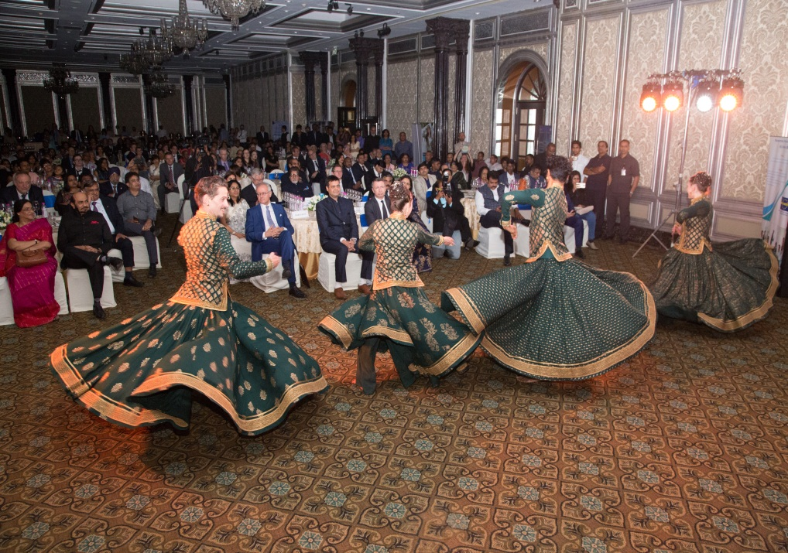

Slide 35
THANK YOU!

