Slide 1

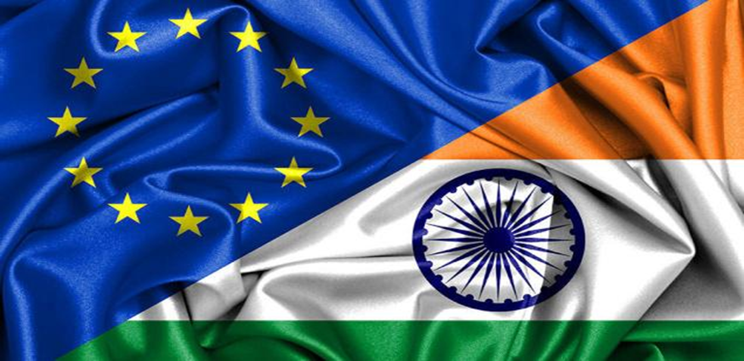
THE COUNCIL OF EU CHAMBERS OF COMMERCE IN INDIA
ENHANCING EU – INDIA TRADE RELATIONS

Slide 2
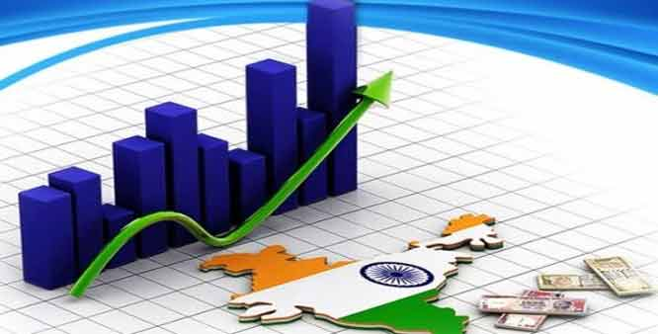

INDIAN ECONOMY
India has been declared the 7th largest economy in the world with a GDP of 2.6 trillion in 2018, as per the recently released report by Indian Monetary Fund (IMF).
India has one of the fastest growing service sectors in the world with an annual growth rate above 9% since 2001.
In FY 2015 and 2018 India's economy became the world's fastest growing major economy, surpassing China.

Slide 3
MAJOR SECTORS IN INDIA
Agriculture
Manufacturing
Services
Banking and financial services
Information technology
Tourism
Infrastructure
Logistics
Telecommunications
Mining and Construction
Foreign trade and investment

Slide 4

EU-INDIA
India is currently the fastest growing economy in the world and a strategic partner for the EU, representing a sizable and dynamic market of 1.25 billion people.
For these reasons, the EU and India are committed to further increase their bilateral trade and investment through the Free Trade Agreement negotiations that were launched in 2007.
India has embarked on a process of economic reform and progressive integration with the global economy that aims to put it on a path of rapid and sustained growth.

Slide 5
EU & INDIA TRADE
The EU is India's number one trading partner (13.5% of India's overall trade with the world in 2015-16.
India is the EU's 9th trading partner in 2016 (2.2% of EU's overall trade with the world.
The value of EU exports to India grew from €24.2 billion in 2006 to €37.8 billion in 2016.
The value of EU imports from India also increased from €22.6 billion in 2006 to €39.3 billion in 2016.
Trade in services almost tripled in the past decade, increasing from €10.5billion in 2005 to €28.1 billion in 2015.
EU investment stocks in India amounted to €51.2 billion in 2015, increasing from €44.2 billion in the previous year.

Slide 6

EU EXPORTS TO INDIA (2017)
(% share)

Slide 7
EU IMPORTS FROM INDIA (2017) (%share)

Slide 8
THANK YOU!

